Slide 1
Analysis of Covariance, ANCOVA (GLM2)
Prof. Andy Field

Slide 2
Aims
When and why do we use ANCOVA?
Partitioning variance
Carrying out ANCOVA using R
Interpretation
  Main effects
  Covariates

Slide 3
When and Why
To test for differences between group means when we know that an extraneous variable affects the outcome variable
Used to control known extraneous variables

Slide 4
Advantages of ANCOVA
Reduces error variance
  By explaining some of the unexplained variance (SS_{R}) the error variance in the model can be reduced.
Greater experimental control
  By controlling known extraneous variables, we gain greater insight into the effect of the predictor variable(s).

Slide 5
Variance
SS_{T}
Total Variance In The Data
SS_{M}
SS_{R}
Improvement Due to the Model
Error in Model
Covariate
SS_{R}

Slide 6
An Example
We will use the Viagra example (from the book).
  There are several possible confounding variables – e.g. partner’s libido, medication.
We can conduct the same study but measure partner’s libido over the same time period following the dose of Viagra.
  Outcome (or DV) = participant’s libido
  Predictor (or IV) = dose of Viagra (placebo, low, high)
  Covariate = partner’s libido

Slide 7
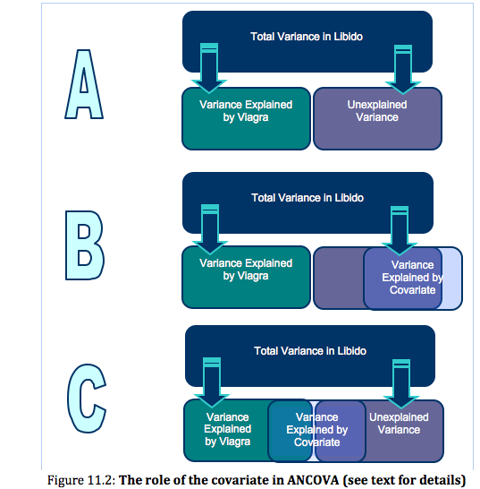
Relationships between the IV and Covariate

Slide 8
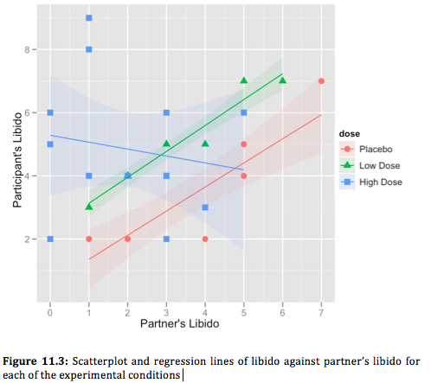
Homogeneity of Regression Slopes

Slide 9
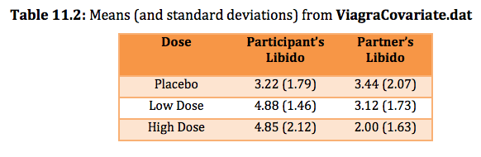

Slide 10
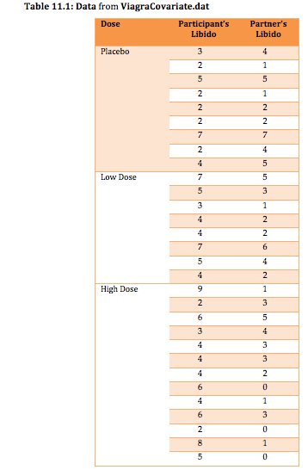

Slide 12

Are the Predictor Variable and Covariate Independent?
We can test this by running an ANOVA with partnerLibido as the outcome and dose as the predictor.

Slide 13
Fitting an ANCOVA model
To create an ANCOVA model we can use the aov() function.
Remember that to add a predictor, we simply write ‘+ variableName’ into the model. So, in Chapter 10 our ANOVA model was:
  viagraModel<-aov(libido ~ dose, data = viagraData)
To add the predictor partnerLibido, we could simply change the model to this:
  viagraModel<-aov(libido ~ dose + partnerLibido, data = viagraData)

Slide 14
Fitting an ANCOVA Model
We need to think about the order of our predictors!
The reason is that when R computes the fit of the model it uses Type I, or sequential, sums of squares by default. This means that any predictor entered into the model is evaluated after predictors before it in the model.
An alternative (adopted by many statistics packages) is to use Type III sums of squares.

Slide 15
Contrasts
Contrast 1: Compare the placebo group to all doses of Viagra.
Contrast 2: Compare the high and low doses:
  contrasts(viagraData$dose)<-cbind(c(-2,1,1), c(0,-1,1))
To run the ANCOVA (with Type III sums of squares) we would execute:
  contrasts(viagraData$dose)<-cbind(c(-2,1,1), c(0,-1,1))
  viagraModel<-aov(libido ~ partnerLibido + dose, data = viagraData)
  Anova(viagraModel, type="III")
The first line sets the contrasts for dose, the second line creates the ANCOVA model, and the third line prints the model summary with Type III sums of squares.

Slide 16
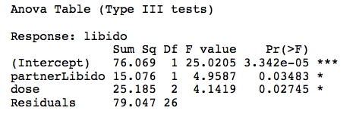
The Main ANCOVA Model

Slide 17
Planned Contrasts in ANCOVA
The overall ANCOVA does not tell us which means differ, so to break down the overall effect of dose we need to look at the contrasts that we specified before we created the ANCOVA model:
  summary.lm(viagraModel)

Slide 18
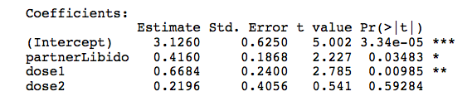
Planned Contrasts in ANCOVA

Slide 19
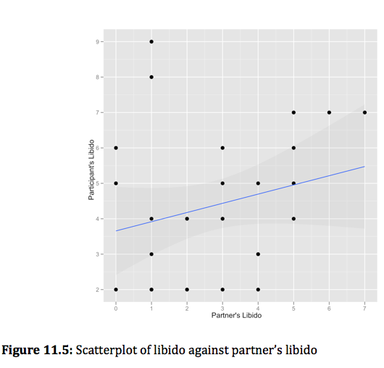
The Covariate

Slide 20
Post hoc tests in ANCOVA
Because we want to test differences between the adjusted means, we can use only the glht() function.
As such, we are limited to using Tukey or Dunnett’s post hoc tests:
  postHocs<-glht(viagraModel, linfct = mcp(dose = "Tukey"))
  summary(postHocs)
  confint(postHocs)

Slide 21
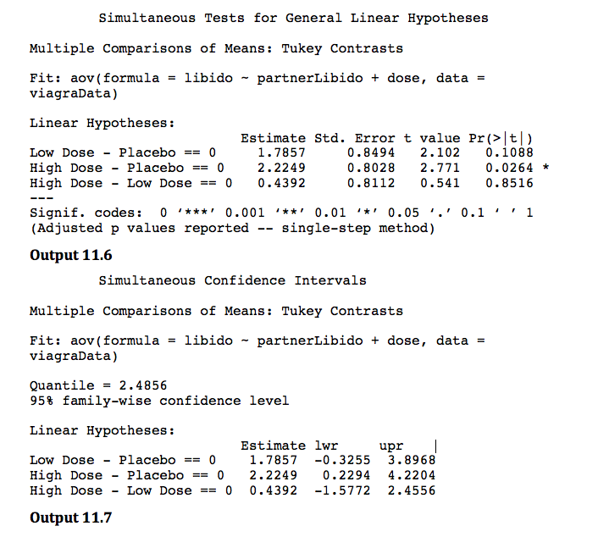

Slide 22
Plots in ANCOVA
Plots of an ANCOVA model

Slide 23
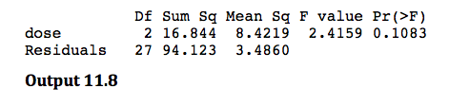
When the Covariate Is Not Included

Slide 24
Robust ANCOVA
Looking at the effect that wearing a cloak of invisibility has on people’s tendency for mischief:
  We recorded how many mischievous acts everyone conducted in the first 3 weeks (mischief1).
  After 3weeks we told about half of the sample (N = 34) that we were switching the cameras off so that no one would be able to see what they were getting up to
  The remainder (N = 46) were given a cloak of invisibility.
  We recorded the number of mischievous acts over the next 3 weeks (mischief2).
The variable cloak records whether or not a person was given a cloak (cloak = 2) or not (cloak = 1).

Slide 25
Boxplots

Slide 26
Getting the Data into the Right Format for Robust ANCOVA

Slide 27
Conducting Robust ANCOVA
  ancova(covGrp1, dvGrp1, covGrp2, dvGrp2)
  ancboot(covGrp1, dvGrp1, covGrp2, dvGrp2, nboot = 2000)

Slide 28
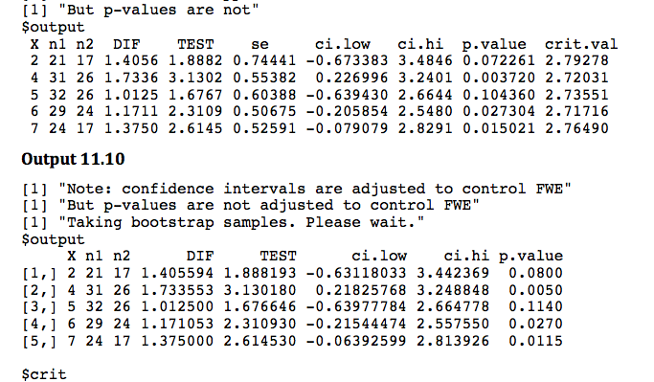
Output

Slide 29
Robust ANCOVA Plot
Plot of baseline mischievousness (X) against post-cloak mischievousness (Y) from the ancova() function

